Slide 1




Impact of incentive contracts on non-profit organisations delivering homelessness interventions through Social Impact Bonds
Stefanie Tan
Postdoctoral fellow
Institute of Health Policy, Management and Evaluation, University of Toronto
Canadian Centre for Health Economics Seminar Series
27 October 2023

Slide 2
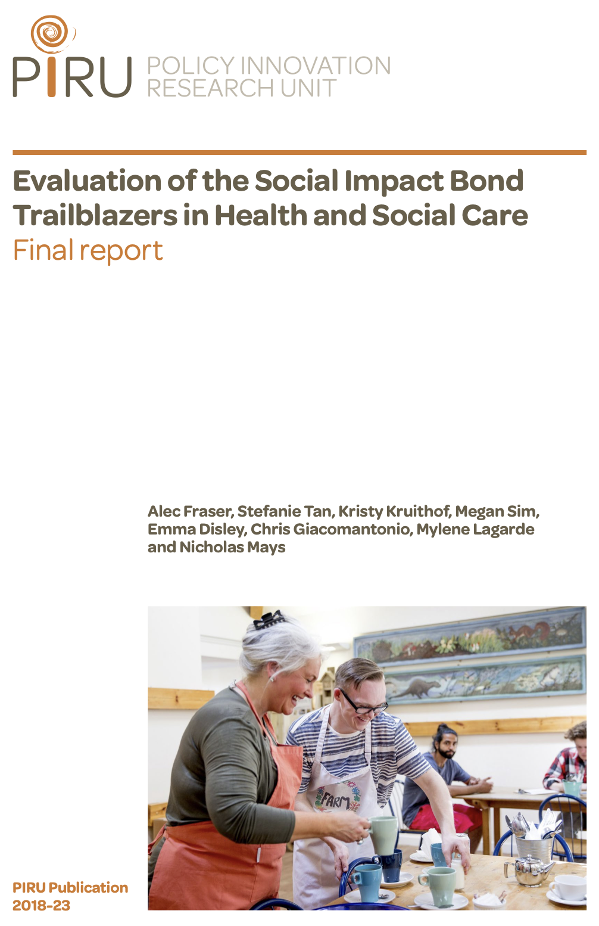
Evaluation of SIBs in UK Health and Social Care
Acknowledgements
This study/project/report is/was funded by the NIHR Policy Research Programme through its core support to the Policy Innovation and Evaluation Research Unit (Project No: PR-PRU-1217-20602 ). The views expressed are those of the author(s) and are not necessarily those of the NIHR or the Department of Health and Social Care.
Research team:
Dr. Alec Fraser, Dr. Stefanie Tan, Dr, Mylene Lagarde, Prof. Nicholas Mays (LSHTM); Dr. Emma Disley, Dr. Chris Giacomantonio, Kristy Kruithof, Dr. Megan Sim (RAND Europe).

Slide 3
What are Social Impact Bonds?

Slide 4
Empirical evidence on SIBs: No magic bullet
Difficult to develop and commission with the potential for high transaction costs, e.g. fees for performance management and intermediaries’ services (Disley et al, 2011; McKay, 2013; DWP, 2014; Tan et al, 2015; Fraser et al, 2018)
SIBs can improve performance or enable a focus on achieving results (DWP 2016; DCLG 2015).
Studies suggest that SIBs do not ameliorate the issues associated with PbR contracting and found anecdotal evidence of gaming (Edmiston and Nicholls 2017; Tan et al, forthcoming) and parking and creaming (Rees et al 2014).

Slide 5

Aims and objectives
Research question:
“How do workers in non-profit organisations respond to the use of direct and indirect outcome-related financial incentives?”
To understand how new financial incentives are articulated and prioritised within a non-profit organisation’s management and how this affects the way that the organisation plans and delivers services.
To understand how senior and team managers respond to extrinsic incentives and the impact that these have on staff structure, task allocation, service delivery, performance management and monitoring outcomes.
To understand how team managers and front line staff perceived incentives and outcome-related rewards driven by the SIB, and how this affects their attitudes toward outcome targets.

Slide 6
Theoretical background
Agency theory
In public services, no single principal (e.g. owner of a private firm) or a single goal but multiple principals and goals in public and non-governmental organisations (Besley and Ghatak, 2003).
Agents can be compromised by the conflict between their own self-interest and the principal’s needs, so their choices can adversely affect their own, or their principal’s professional or financial outcomes (Prendergast, 1999).
Incentives theory
Mechanism to induce workers into acting in the interests of their employers (Prendergast, 1999).
Structure of rewards, encouragement, praise or criticism to promote effort or performance (Benabou and Tirole, 2003).
Incentives in public sector can be more challenging where agents have multiple tasks, different principals and missions (Besley and Ghatak, 2003)

Slide 7
Theoretical background: Motivation
Intrinsic motivation is defined as actions an individual undertakes for the enjoyment of the task itself, for public service motivation, or out of pro-social motivation to ‘do good’.
Extrinsic motivation refers to activities that are not interesting to the individual (i.e., not intrinsically motivating), such as externally or internally imposed tasks that do not correspond to an individual’s goals, values, or preferences.

Slide 8
Theoretical background: Motivation
Motivation crowding theory: continuum of individual preferences along two poles (Frey and Jegen 2001).
But…
Move away from the dichotomisation of intrinsic and extrinsic motivation to understand how financial incentives can foster motivation for some while impeding it in others. (Gagne and Deci 2005)
Crowding ‘in’ of IM where incentivised tasks provide enjoyment or personal meaningfulness that reflects the individual’s goals and values (Lohmann et al 2016).

Slide 9
Study setting
Greater London Authority commissioned two SIBs in London with two non-profit service providers to reduce entrenched rough sleeping for 830 individuals in target population
Each SIB responsible for fixed cohort of 415 people for 3 years (Nov 2012-Oct 2015)
Housing-first approach consistent with current best practice in enabling health improvements and socio-economic integration of homeless people (Fitzpatrick-Lewis et al., 2011, Bretherton and Pearce 2015).
Direct financial incentives for the organisation
Indirect financial incentives for staff (no performance-based funding component for salary)

Slide 10
Outcomes
Outcome | Proportion of allocated funding
Primary outcomes
Reduction in bedded down sightings | 25%
2. Accommodation i. Enter accommodation | 40%
ii. 12 months sustained accommodation
iii. 18 months sustained accommodation
3. Repatriation i. Repatriation to country of origin
ii. 6 months sustained repatriation | 25%
Secondary outcomes
4. Supporting employment, education or training | 5%
5. Improved health | 5%

Slide 11
Framework for analysis

Slide 12
Methods 1/2
Two case study sites in Greater London, UK (2014-2018)
Documentary analysis of legal contracts between the Greater London Authority and each non-profit case study organization
In-depth semi-structured interviews (n=39 with 25 informants drawn from managers and staff in two non-profit organisations)
Interviews analysed in NVivo11
Quantitative analysis was impossible due to reporting bias in dataset

Slide 13
Methods 2/2
Use of comparative qualitative case-studies:
Qualitative methods are a useful tool in health economics when applied to complex issues such as financial incentives and allow the researcher to obtain information that contributes to the development of economic models and theory that reflect the complexity of the health economy informed by the views and preferences of individuals in that economy (Coast and Jackson, 2017).
This research draws on economic theory about agency, incentives and motivation to inform an analysis about the impact of a complex financing arrangement throughout an organisational hierarchy that accounts for the views and experiences of individuals within the case studies.

Slide 14
Contract design
SIB diagram: Provider A

Slide 15
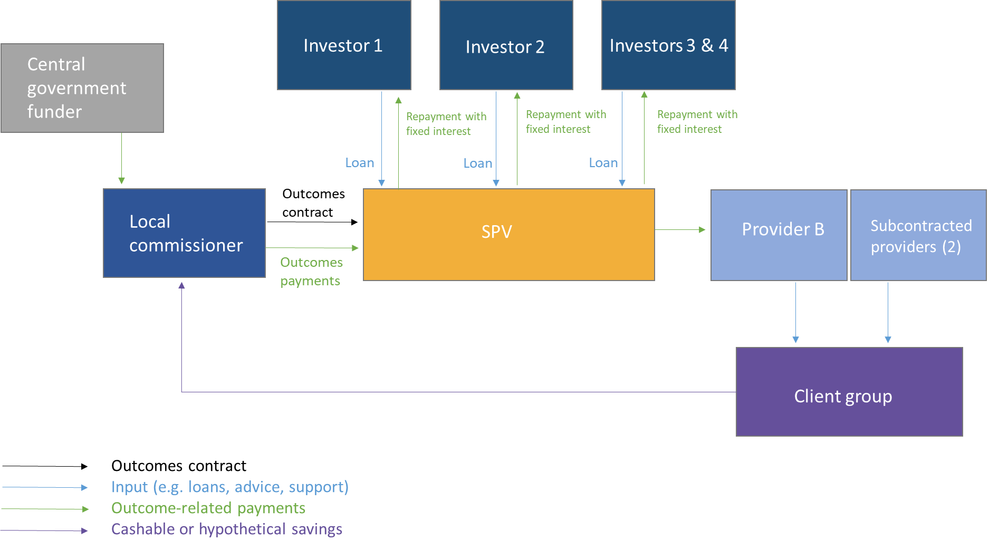
Contract design
SIB diagram: Provider B

Slide 16
Contracts analysis
Different thresholds of outcomes achievement in study sites for primary outcomes

Slide 17
Findings: Senior leadership team (SLT)
Providers in both case study sites held 100% outcomes-based contracts with the government (investors as new principal).
Both sites shared more financial risk of failure but…
  Site A framed the project as an entrepreneurial endeavour to grow the organisation.
  Site B were less anxious about the reputational implications of poor performance and framed the SIB as an learning opportunity
SLT at Provider A stressed the importance of meeting outcomes while in Provider B emphasised their slower approach to outcomes generation.

Slide 18
“If there’s any sign they’re going to move off the street, we’ll be around that person like wasps round a honeypot... We’re entirely committed to getting the most vulnerable off the street, but we have to decide where we were going to focus our attention.”
Senior manager (A1)
“…there’s always the risk that if it is a program where some degree of gaming or cherry picking is available, are the people who need these services the most actually getting those needs neglected, because there’s nothing triggering it, minus like the confidence or we’re working with people who are highly motivated to help people, so we’ll just trust their best judgement, which is great and it’s largely true, but it’s not always true? You’re taking a real leap of faith on the organisations hiring the right people and hoping that they do good work so therefore their teams will do that.”
(Director, B1)

Slide 19
Characteristics of staff structure in case studies
 | Provider A | Provider B
Managerial team | One team manager for the SIB team for 3 years, changing during each year of the intervention (4 in total) | Two team co-managers in post for 3 years. One remaining in post for year 4.
Administrative support | Part time administrator in year 1 | One outcomes officer responsible for all administrative work related to evidencing outcomes, in post for 3 years.
Staff size | 7 front line workers for the first year of the project, reduced to 4 in the second and third year. One staff member for Q1 of the fourth year. | 10 front line workers for the first two years of the project, reduced to 8 for the third year and 4 in the fourth year (ultimately 3 staff members as one went on sick lead in Q2 of the fourth year).
Use of unpaid workers | Use of social work interns from Scandinavian university on 3-6 month placements throughout intervention, use of volunteers and peer support members conducting face to face contacts with clients. | Some use of volunteers to assist with attending benefits tribunals or job centre appointments.

Slide 20
Findings: Team managers
Team managers played important role in framing importance of outcomes
  Provider A: Strong push for outcomes, high attrition (4 managers in 3 years)
  Provider B: Confident approach to outcomes over longer time period, stable managers (same for 3 years)
Team managers set tone for service delivery and what was expected of staff

Slide 21
“I was very conscious that they didn't get wrapped up in the outcomes…
“salaries aren’t payment by results and we’re not doing performance reviews of, you need to get X amount of tenancies, you need to get this, that and the other.”
(Team manager, B3)
“If you miss one, this much [money] we lose. And that motivated the team… to make them outcome focused, we know the client is going to benefit in the end”
(Team manager, A5)

Slide 22
Findings: Front line staff
Front line provider behaviour was affected by the way that managers communicated the importance of meeting outcomes and staff structure.
Front line staff welcomed opportunity for personalisation and to develop long term pathways for clients’ social reintegration but some felt PbR was inappropriate method
Team managers strongly influenced the importance front line staff placed on outcomes
  Provider A: Strong focus from team managers on mitigating financial risk manifested itself in evidence of parking and cream skimming. Some evidence of gaming through the falsification of documents.
  Provider B: Focus on equitable treatment of cohort, strong focus on client-centred care

Slide 23
“I don’t think it was ever, you know, the money side of it was ever hidden. I think it was quite open and I think… in a way, I think it worked well because it, it was a target that people wanted to get. People wanted to obviously get the higher numbers, and it felt quite satisfying as a worker to, to gain, not obviously personally gain money, but to gain money for your team, because we were being measured on our success in that way.”
(Front line staff, A13)
“If I had the option of moving someone into a hostel or into a flat, when actually what they really needed was a supported hostel, and I sort of said at the time, you know, I could put him here and get the outcome but actually he really needs to be there, yeah, right, we'll put him there then. You know, forget that, this is [outcomes-based], it has to be what is best for him.”
(Front line staff, B7)

Slide 24
“The ethos of payment of results don’t work in the context of when you work with complicated people, because you’re putting more effort in, more time in, more resources in, but you’re not getting anywhere.”
(Front line staff, A7)
“…even if I'd had internalised all those figures, it wouldn't have made any difference to the way I was working anyway. So, I didn't, because I was, I was trying to get outcomes for whoever I could anyway, the money was more of a side issue.”
(Front line staff, B8)

Slide 25
Summary of provider performance

Slide 26
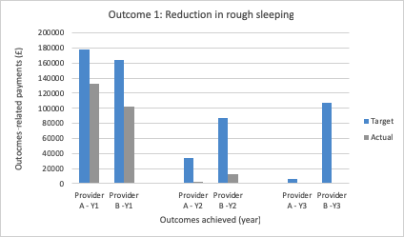
Outcome 1: Reduction in rough sleeping

Slide 27
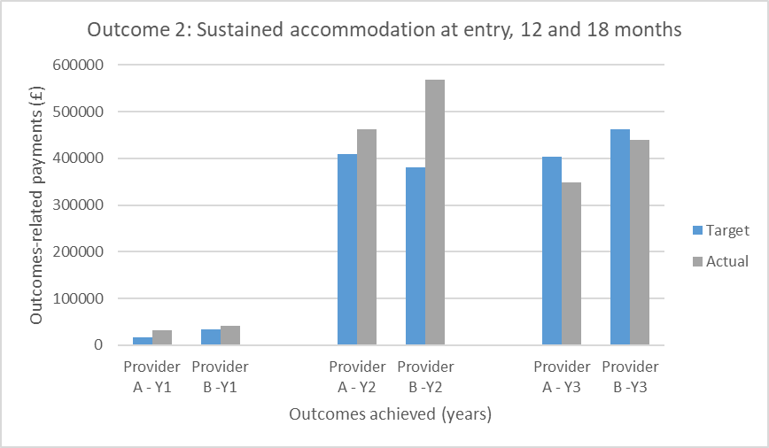
Outcome 2: Sustained accommodation at entry, 12 and 18 months

Slide 28
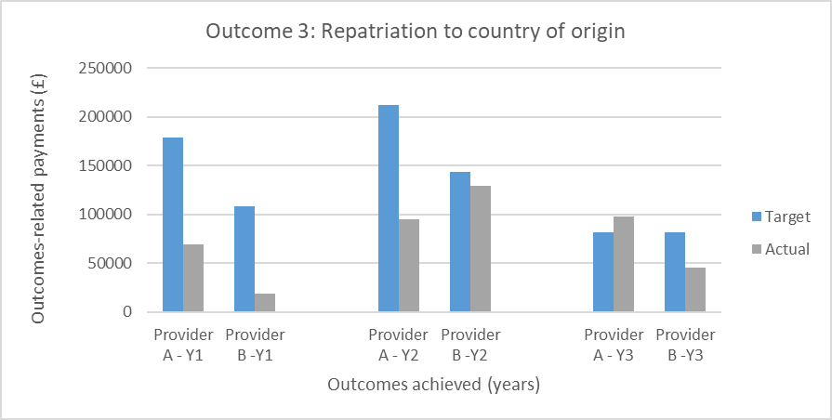
Outcome 3: Repatriation to country of origin

Slide 29
Summary of provider performance
Providers A and B tended to underperform to varying degrees on Outcomes 1 and 3.
Both providers were more successful in meeting, and exceeding, targets associated with sustained accommodation (Outcome 2). Provider B gained more income from this outcome than Provider A.
It is not possible to report whether Provider A or B made surpluses or losses based on the information made available to the research team.

Slide 30
Conclusions
Use of outcomes-based contracts are complex, can lead to unintended behavior (more flexibility, foster too much dependence, enable personalization but also creaming, and gaming)
Strategic importance of the SIB-related incentives for each non-profit organisation impacted staff and service delivery to the client group.
New principal (profit-seeking investor) can change a non-profit’s agency relationship
Introduction of incentives has potential to affect non-profit provider behavior

Slide 31
Discussion of findings
Explores the implications of the financial and contractual relationships underpinning the SIB contracts and the impact for provider behaviour.
Builds on existing theoretical work about the use of incentives in non-profit or public sector settings (Francois and Vlassopoulos, 2008, Besley and Ghatak, 2003).
Contributes to gap in the empirical literature about how incentives within organisations and how this affects organisational behaviour (Milstein and Schreyoegg, 2016; Bandiera et al 2006; 2007; Burgess et al 2017; 2017).

Slide 32
Strengths and limitations of study
Comparative case studies allowed identification of incentives and their impact as they filtered through an organization
Rich descriptive evidence about how incentives used and understood by staff in shaping service delivery
Contributes to nascent literature on intrinsic motivation within teams using indirect financial incentives
Limitations
  Unable to collect observational data about service intervention at outset
  Impossible to determine potential surpluses or losses that each provider may have accrued to better understand the impact of the contractual risks on service delivery
  Unable to conduct quantitative analysis due to reporting biases in data available

Slide 33
Policy implications
  SIBs and outcomes-based contracts should be approached with caution about the appropriate allocation of risk
  Non-profit management and leadership are important contextual factors for service delivery and implementation because providers are susceptible to the perverse incentives associated with p4p schemes
  Non-profit providers are susceptible to the perverse incentives associated with p4p schemes
  Attribution of outcomes to the SIB-financed intervention should be prioritised in future projects and more more robust research (use of counterfactuals or randomised design) is needed

Slide 34



IFP Catalyst grant:
Outcomes-based contracting for resilient health systems in Canada
Developing resilient health systems to withstand future emergencies and public health challenges (e.g., pandemics and chronic health conditions) is a key policy priority in Canada.
We will examine outcomes-based contracts (OBCs) as a policy lever to enable cross-sector collaboration to coordinate and share resources for innovative service delivery.
Research underway to test claims made within the Canadian literature on OBCs through workshops with relevant stakeholders to draw out key implications for the Canadian health system context, including considerations for when to use OBCs and how to mitigate risks

Slide 35
Stage 1 findings:
Outcomes-based contracting for resilient health systems
There are 3 health sector OBCs operating in Canada.
There is currently insufficient Canadian data to substantiate or trial claims made within the literature regarding the benefits or challenges of OBCs, nor have strategies to mitigate risks been tested.
Governments should carefully consider how to identify specific social challenges, and partnerships; develop projects, outcomes and evaluations; structure payments; attract investors and negotiate contracts with them.​

Slide 36
References
BANDIERA, O., BARANKAY, I. & RASUL, I. 2006. The evolution of cooperative norms: Evidence from a natural field experiment. Advances in economic analysis & policy, 5, 1-28.
BANDIERA, O., BARANKAY, I. & RASUL, I. 2007. Incentives for managers and inequality among workers: Evidence from a firm-level experiment. The Quarterly Journal of Economics, 122, 729-773.
BENABOU, R. & TIROLE, J. 2003. Intrinsic and extrinsic motivation. The Review of Economic Studies, 70, 489-520.
BURGESS, S., PROPPER, C., RATTO, M., SCHOLDER, K., VON HINKE, S. & TOMINEY, E. 2010. Smarter Task Assignment or Greater Effort: The Impact of Incentives on Team Performance. The Economic Journal, 120, 968-989.
BURGESS, S., PROPPER, C., RATTO, M. & TOMINEY, E. 2017. Incentives in the public sector: Evidence from a government agency. The Economic Journal, 127, F117-F141.
ELDRIDGE, C. & PALMER, N. 2009. Performance-based payment: some reflections on the discourse, evidence and unanswered questions. Health Policy and Planning, 24, 160-166.
FRANCOIS, P. & VLASSOPOULOS, M. 2008. Pro-social motivation and the delivery of social services. CESifo Economic Studies, 54, 22-54. Hood, C. 1995. "The “New Public Management” in the 1980s: variations on a theme." Accounting, organizations and society 20 (2):93-109.
FRASER, A., TAN, S., KRUITHOF, K., SIM, M., DISLEY, E., GIACOMANTONIO, C., LAGARDE, M. & MAYS, N. 2018a. An evaluation of Social Impact Bonds in Health and Social Care: Final Report. Policy Innovation Research Unit (PIRU).
FRASER, A., TAN, S., LAGARDE, M. & MAYS, N. 2018b. Narratives of Promise, Narratives of Caution: A Review of the Literature on Social Impact Bonds. Social Policy & Administration, 52, 4-28.
HOOD, C. 1995. The “New Public Management” in the 1980s: variations on a theme. Accounting, Organizations and Society, 20, 93-109.
LAGARDE, M., WRIGHT, M., NOSSITER, J. & MAYS, N. 2013. Challenges of payment-for-performance in health care and other public services–design, implementation and evaluation. London: Policy Innovation Research Unit.
LAKE, R. W. 2015. The financialization of urban policy in the age of Obama. Journal of Urban Affairs, 37, 75-78.
MILSTEIN, R. & SCHREYOEGG, J. 2016. Pay for performance in the inpatient sector: A review of 34 P4P programs in 14 OECD countries. Health Policy, 120, 1125-1140.
PRENDERGAST, C. 1999. The provision of incentives in firms. Journal of Economic Literature, 37, 7-63.

