Slide 1
Applied Artificial Intelligence in Healthcare: Trials, Tribulations, and Value Assessment
Muhammad Mamdani, PharmD, MA, MPH
Vice President, Data Science and Advanced Analytics, Unity Health Toronto
Faculty Affiliate, Vector Institute
Professor, University of Toronto
February 2020

Slide 2
The Data and Analytics Revolution
Technology and Artificial Intelligence

Slide 3
Buzz Words: Artificial Intelligence – What Is it?
Google dictionary
the theory and development of computer systems able to perform tasks that normally require human intelligence, such as visual perception, speech recognition, decision-making, and translation between languages
How do computers ‘learn’??
Data… lots and lots of data
Processing… ability to ‘look’ through data quickly
Rules… some guidance

Slide 4
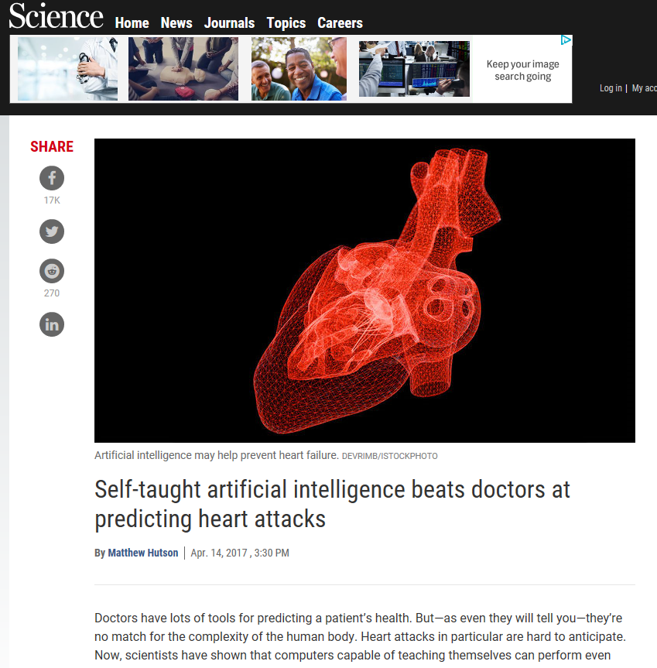
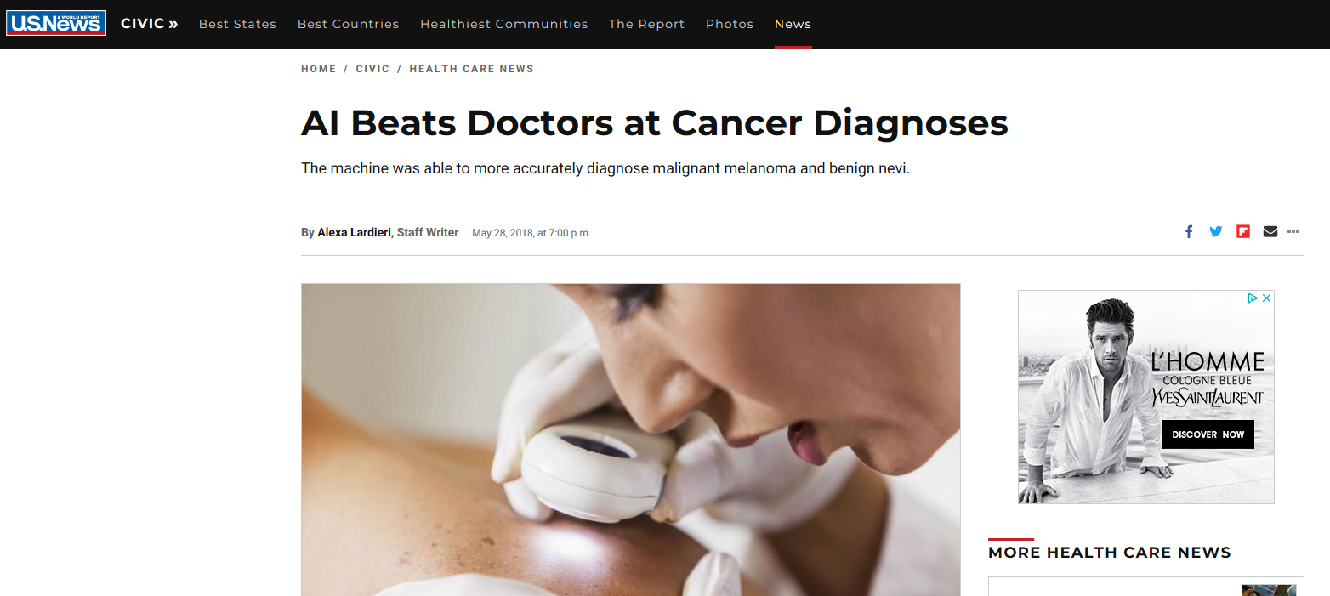
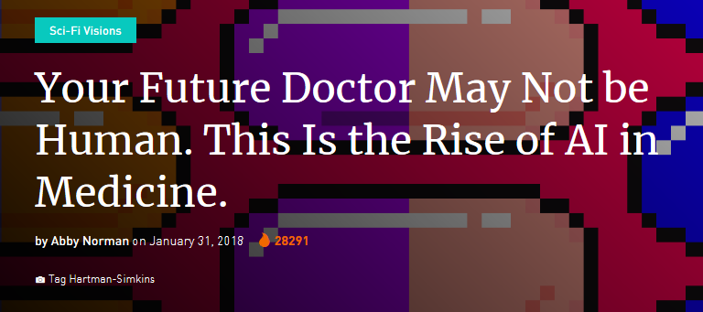
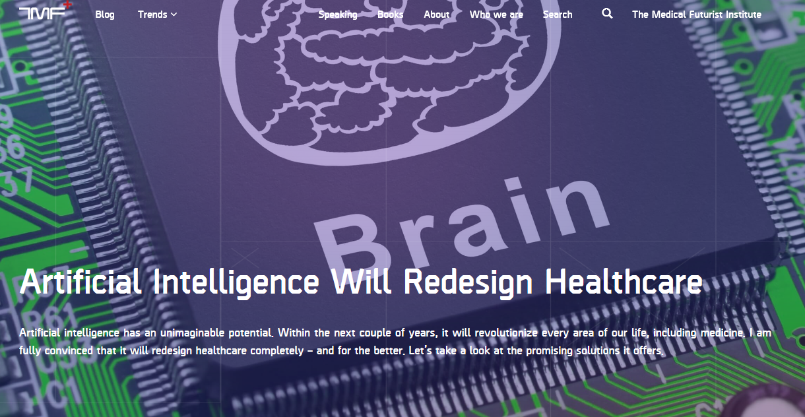
The AI ‘Hype’ in Healthcare

Slide 5
Can The AI Hype be Realized in Healthcare? Case Study: Unity Health Toronto

Slide 6
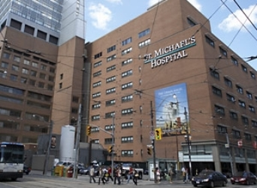
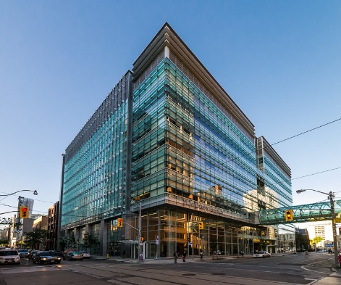
Unity Health Toronto: St. Michael’s Hospital
St. Michael’s Hospital
Tertiary care teaching hospital in downtown Toronto
Established in 1892 with the founding goal of taking care of the sick and the poor of Toronto’s inner city
1 of two adult trauma centres in the GTA
463 beds and numerous outpatient clinics
> 6,000 staff
> 900 physicians; > 1,600 nurses
Approximate annual patient volumes
> 75,000 ED visits
> 500,000 ambulatory visits
> 25,000 inpatient visits
Research: Li Ka Shing Knowledge Institute & Keenan Research Centre
> 200 investigators; > 800 staff
Fully affiliated with the University of Toronto
Part of the Toronto Academic Health Sciences Network (TAHSN)

Slide 7
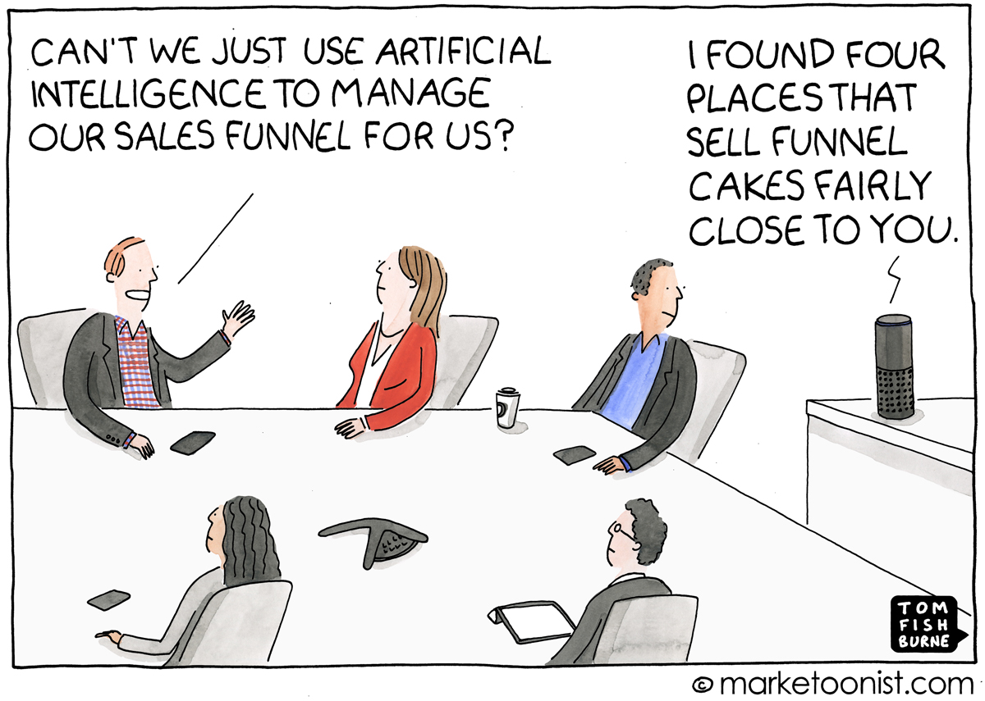
Applying AI in Healthcare: How Hard Could it Be??

Slide 8
Recruiting a Data Scientist / Team to Do ‘Stuff’
TEAM
At work

Slide 9
The Hospital Data Dilemma

Slide 10
‘Advancing’ Advanced Analytics in the Hospital
Vision
Infrastructure
People & Culture
Process
Lessons

Slide 11
Advanced Analytics at Unity Health Toronto
Vision – What Do We Want to See?
Make data and analytics an integral part of clinical and management decision-making to drive better patient outcomes and improve hospital efficiency
Components of the Vision
Readily available, ‘up to date’, high quality data
Define end-users and understand their needs: clinicians and management
Highly skilled data scientists: engineering, statistics, computer science
Software and hardware to enable advanced analytics
Data governance and access model that balances privacy with data accessibility
Engaged and ‘data literate’ hospital community

Slide 12
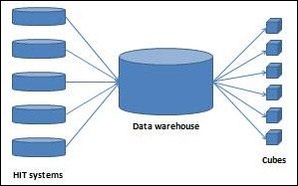
Creating a Leading AI Program at a Hospital
Faculty of Medicine
Department of Computer Science
Faculty of Engineering
The Most Advanced Hospital-Based Applied AI Program in Canada
Department of Statistics

Slide 13
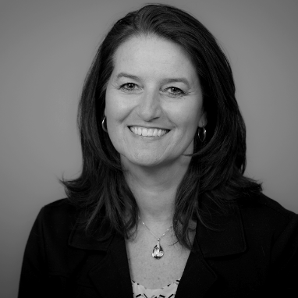
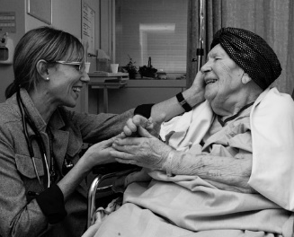
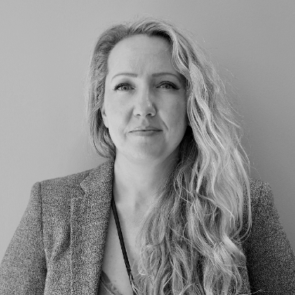
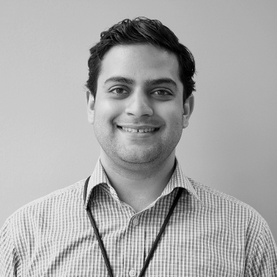
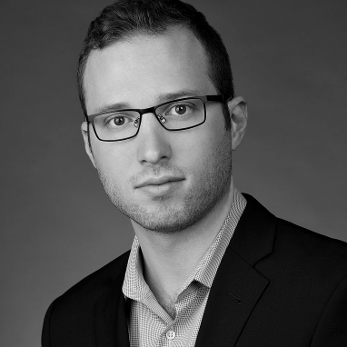
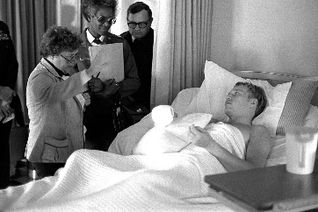
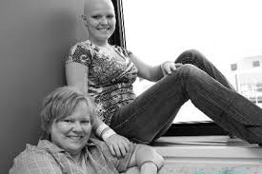
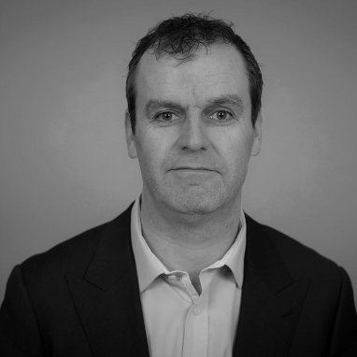
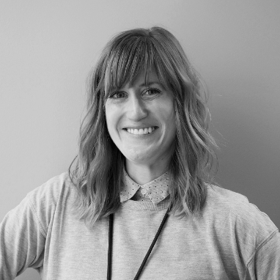
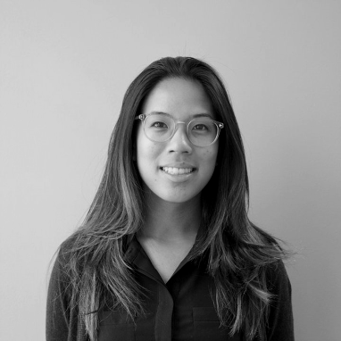
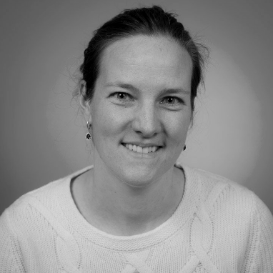
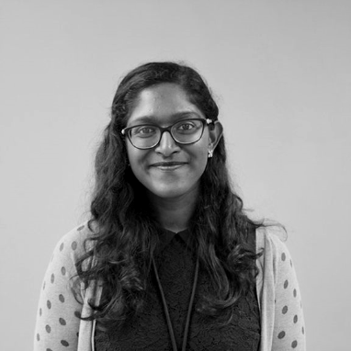
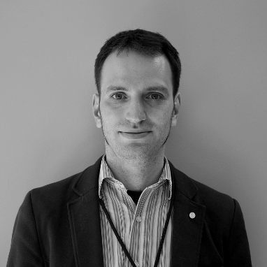
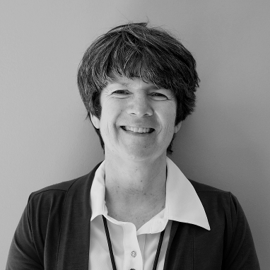
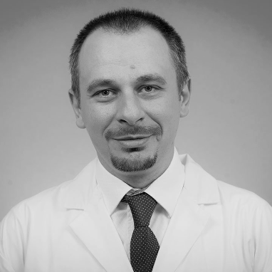
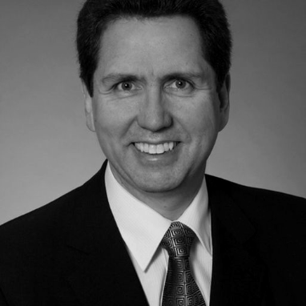
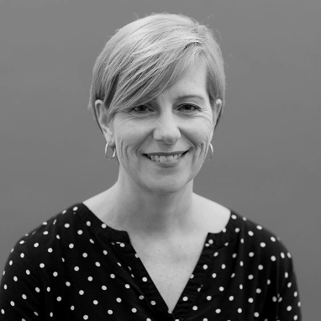
People and Culture: The Analytics Community
Notes:
We’re a bunch of data geeks who really like math.
But we’re more than that.
The reason why our math works so well is that we’re a community… the questions we work on don’t come from us – they come from our nurses, doctors, pharmacists, physiotherapists, hospital administrators, and patients. These very people who care for our patients and ARE our patients not only ask the questions, but they lead the projects with our support, so we as a community collectively own it.
Why does our model work? We all work together because we have a common cause: life.

Slide 14
The Process
Project ideas / questions come from end-users (management and clinical) NOT from the Analytics Team (DSAA)
Projects the DSAA will work on (from highest to lowest priority):
Initiatives that have promise to improve patient outcomes AND reduce costs
Initiatives that have promise to improve patient outcomes at no additional cost
Initiatives that have promise to reduce cost but not adversely affect patient outcomes
All other initiatives that are prioritized by management and/or clinical leadership
The majority of projects must have Unity Health Toronto leadership (management and/or clinical leadership) support to enact CHANGE
Where relevant, projects will have an evaluation component to assess impact and ROI
Target project duration: 3-6 months
Current Project Portfolio: 20+ projects at any time

Slide 15
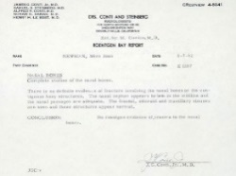
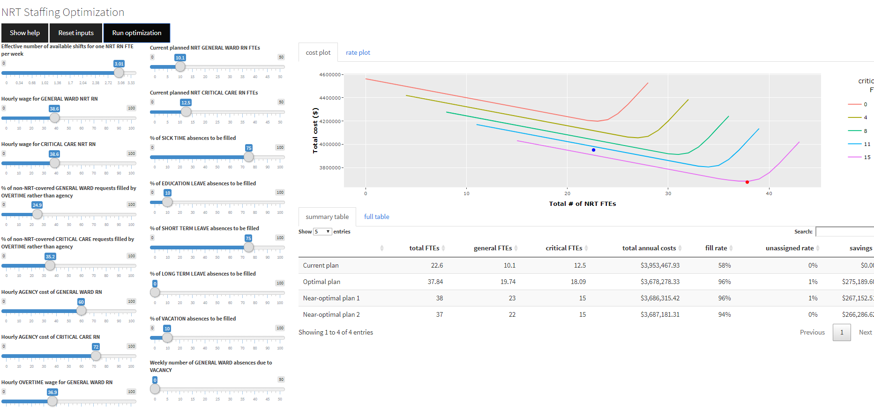
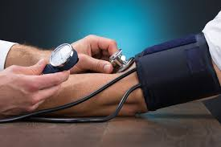
Analytics at St. Michael’s Hospital: Examples and Lessons
Predicting When Patients Do Poorly
Emergency Department Wait Times
Optimizing Nurse Staffing
Forecasting patient volumes 3 days to 3 months in advance
94-96% accuracy
Optimize Nurse Resource Team Staffing at St. Michael’s and St. Joseph’s
$1 million cost reduction annually
Predict 24H in Advance: ICU Transfer or Death
> 98% accuracy
↑ Patient Outcomes
↓ Wait Times
↑ Quality of Care
↓ Cost
↑ Quality of Care
Key Lessons: Human Factors, Visualization, and Workflow
Key Lessons: End-User Needs and Customization
Key Lessons: User Acceptance, Legal/Ethical, Implementation

Slide 16
Case Example 1: Emergency Department Volume Forecasting
Joint initiative between LKS-CHART and ED leadership
Forecast ED volumes to assist in staffing decisions using historical volumes, weather, and city events
6-hour intervals over 3 days, 1 week, 2 week, 4 week, 12 week forecasts; updates daily
Accuracy: 94-96%
Pilot implemented at St. Michael’s Hospital; now implemented at 2 other GTA hospitals; 2 more hospitals pending

Slide 17
Bringing AI To Practice

Slide 18
The Realities….
Initial model development
Awesome – we’re really good at it!
Product development
Lack of human factors experts, graphics / artists / visualization experts, software developers
‘Amateur’ strategy: end-user driven interface development… chaos
Led to patch-work solution
Implementation and change management
Initial process: model ‘handed over’ to ED leadership
Nobody used it for first month
Sentinel event drove leadership to push tool use into workflow
Brought in a designer and considered human experience much more seriously

Slide 19
Current Uptake
Graph at bottom of the page shows usage statistics - St. Mike’s averages 5-6 views per day
Team uses information to support both staffing and patient flow decision making process
Qualitative feedback has highlighted strength of tool to provide situational awareness – when to replace a sick call; call in an extra ED physician; plan ahead during times of reduced capacity
Quantitative evaluation pending

Slide 20
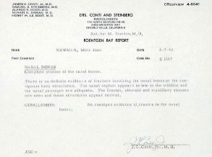
Case Example 2: CHARTwatch
Joint initiative between LKS-CHART and GIM clinicians and leadership
1/13 GIM patients die or go to the ICU
Deep learning model routinely ingests data to predict transfer to ICU or death
Labs, orders, medications, vitals, text notes, etc
> 800 variables considered in model
Model trained and tested on about 20,000 GIM patients at SMH
Model performance
Overall accuracy > 98%
Pilot ‘silent’ implementation: November 2019
Prediction 24 in Advance: ICU Transfer or Death

Slide 21
The Realities

Slide 22
The Realities
Unintended consequences – need for rigorous evaluation
Increased use of ICU, increased mortality, alarm fatigue
Balancing performance with workflow
Alarm frequency, sensitivity vs positive predictive value
Activate paging system vs dashboard presentation vs email
Privacy and transparency
Notify the clinical team, patient, caregivers, all of the above?
Ethical and legal issues
What happens when the clinician doesn’t agree with the AI prediction and someone dies?

Slide 23
The Learnings
AI Development
Data Scientists
Project Managers
Clinicians
Management Leadership
Product Development and Maintenance
Human Factors Experts
Graphics Designers / Visualization Experts
Data Engineers / Integration Experts
Software Developers
Implementation, Change Management, and Evaluation
End-User Buy-In
Change / Project Managers
Evaluation Teams
Developing and Implementing AI Solutions May Require A Major Investment and Culture Shift

Slide 24
Key Learnings for Clinicians and Administrators
Not everything needs to be addressed with ‘AI’
AI is an ‘arrow in the quiver’
High quality, readily accessible, and timely data is a prerequisite to ‘good’ analytics
Not all data scientists are created equally
Need a rigorous process for establishing a data science team
End-users need to be fully engaged throughout the AI development and implementation process
AI is not just about model development; considerable time and investment is needed for successful implementation and maintenance

Slide 25
Assessing ‘Value of AI’ in Healthcare

Slide 26
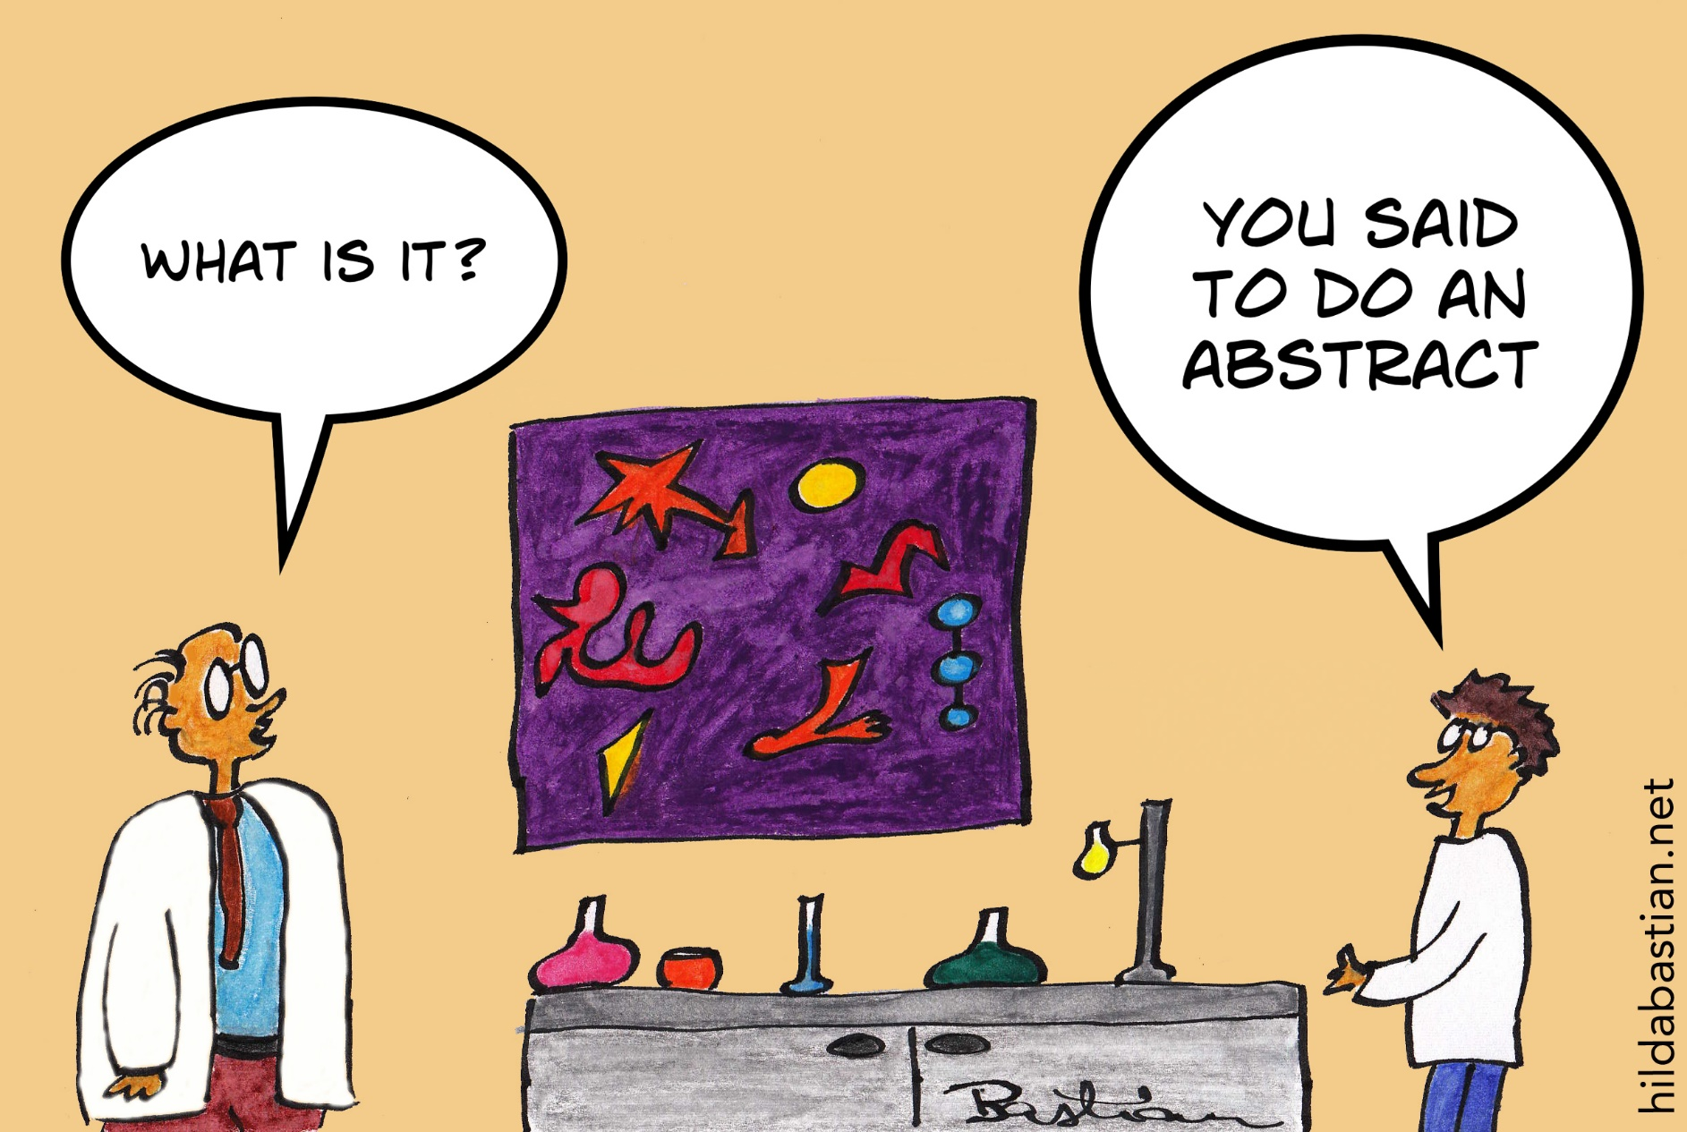
What is Value?

Slide 27
Defining Value
Wikipedia: Economic value
A measure of the benefit that an economic actor can gain from either a good or service
Oxford Dictionary
The material or monetary worth of something
Health Policy Lay Terminology
A judgement by a decision-maker on the financial worth of the net benefit of a product or service

Slide 28
Defining Value in Healthcare… Perspectives
Clinician
Payer
Patient
Case
An AI tool will soon be available that is expected to significantly reduce mortality by 20% relative to standard care but its licensing costs are considerable. It comes with a significant learning curve for physicians and staff (i.e. not easy to implement) and its false positive rate is higher than desired.
Clinical and economic considerations

Slide 29
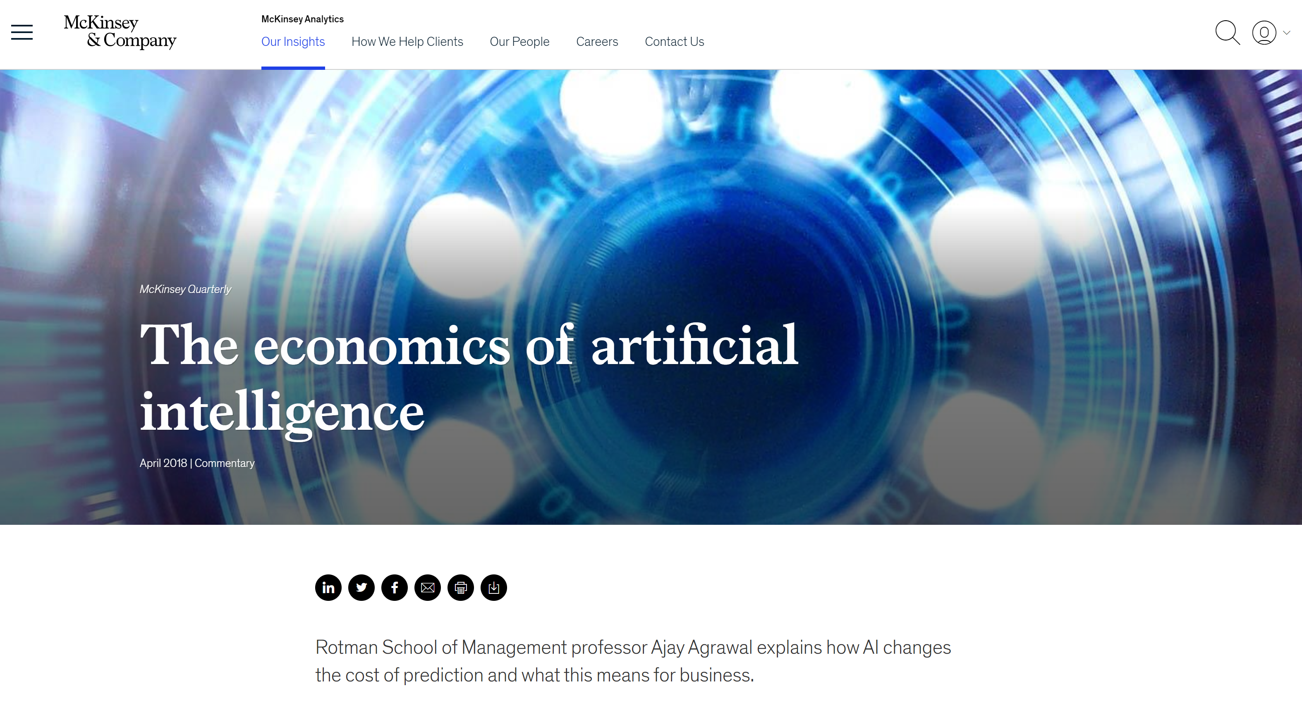
Assessing Value: Economic Evaluation
Key Question
How much will it cost to achieve one unit of ‘benefit’?
Traditional economic evaluation
Cost minimization
Cost-consequence
Cost-benefit
Cost-effectiveness
Cost-utility

Slide 30
Cost-Effectiveness Grid

Slide 31
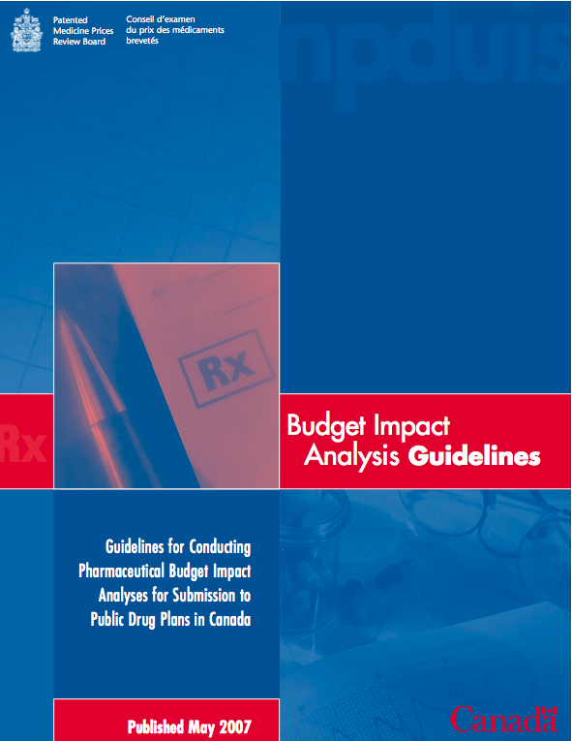
Defining Value: Canadian Health Technology Assessment Guidelines
Cost Effectiveness
Budget Impact

Slide 32
How Would You Assess Costs and Effectiveness of AI Interventions?
Perspective and context
Effectiveness
RCTs vs. pragmatic RCTs vs observational studies
AI ‘tool’ +/- intervention
Unintended consequences
Costs
Direct: includes cost of the ‘AI tool’ + intervention
Indirect
Intangibles
Quality of Life
Survival / mortality
Estimation / Modeling Approach

Slide 33
Discussion
Website: www.chartdatascience.ca Twitter: @Chart_DataSci

